Slide 1


The Peer Researcher Journey
Reflections

Slide 2
Introductions
Dr Gill McGill
gill.mcgill@northumbria.ac.uk
Associate Professor of Health Policy and Research
Co-Director of the Northern Hub for Veterans and Military Families Research Hub
Mary Moreland MBE
mary2.moreland@northumbria.ac.uk
PhD Candidate

Slide 3

Overview
Researcher perspective:
Integrating a peer-led approach
Key considerations, strengths and limitations
Peer-researcher perspective:
Personal experience
Research journey to PhD

Slide 4

Researcher Perspective
Peer-informed research
Lived experience
Strengths
Limitations
Impact

Slide 5

Peer-informed Research
Supporting and promoting understanding aligned with lived experience
Bridging the gap between academic theory, research design and delivery and practice, policy and dissemination.
Different perspectives, strong credibility and authenticity
Social connection, advocacy and inclusion

Slide 6

Lived Experience
Empowerment and depth of insight.
Contextual relevance
Ethical considerations
Improved research outcomes

Slide 7

Strengths
Enhanced Participant Engagement
Trust
Practical Insights for Solutions
Increasing understanding of vulnerability and trauma

Slide 8

Limitations
Personal narrative and subjectivity
Emotional impact
Research skills and knowledge
Interpretation of data

Slide 9

Impact
Relevant and inclusive policies
Improved service delivery and practice
Evidence-based solutions
Enhanced public trust and engagement

Slide 10
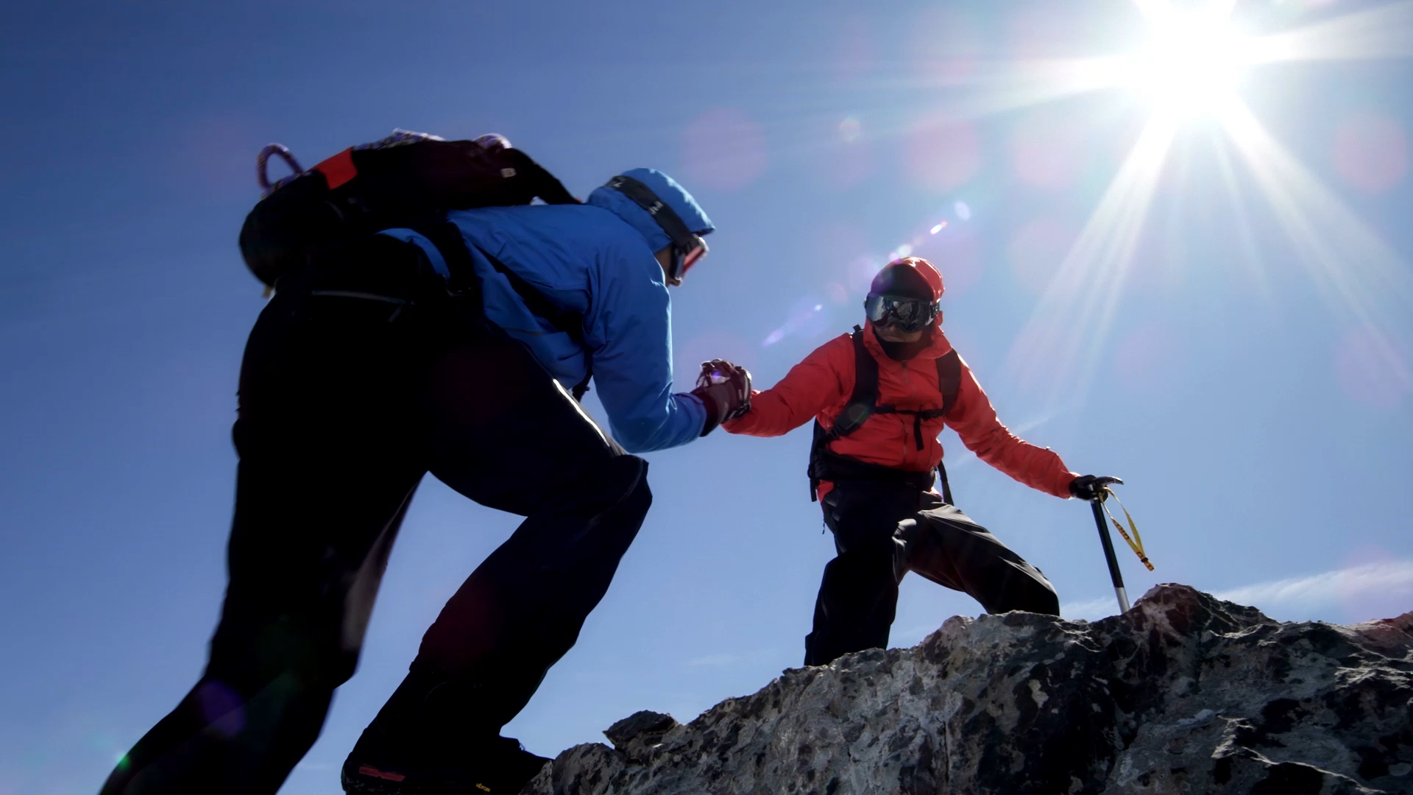

Slide 11

Case Study – Knock on the Door and Beyond
Peer Researcher Journey
Personal Experience
Mary Moreland

Slide 12

This Photo by Unknown Author is licensed under CC BY

